Slide 1
Violent Extremism and (de)Radicalisation in Southeast Asia
Presentation to Conflict Analysis and Prevention Centre (CAPC), 26 Feb.2021
Shashi Jayakumar, Head, Centre of Excellence for National Security (CENS)
S.Rajaratnam School of International Studies (RSIS)
Nanyang Technological
University, Singapore

Slide 2
(A) Regional Context (B) Southeast Asia : The Pull of ISIS (C) The Singapore experience - Jemaah Islamiah - More recent period (self-radicalised, ISIS) (D) Other perspectives - What Singapore is doing : Rehabilitation (E) The Future/Upstream Initatives
CONTENTS

Slide 3
SOUTHEAST ASIA(S)

Slide 4
Southeast Asia

Slide 5
Source : https://theaseanpost.com/article/threat-terrorism-southeast-asia-2018

Slide 6
Jemaah Islamiah
Bali Bombing (2002)
Hambali
Amrozi
Imam Samudra
Mukhlas

Slide 7
Southeast Asian Foreign Fighters
Age of ISIS (from c.2013)
Malaysia : 100-200
Indonesia 400-600
Singapore : “a handful”
Philippines : 100 (?)
Various official/media Sources

Slide 8
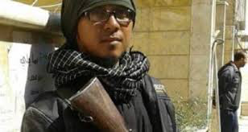
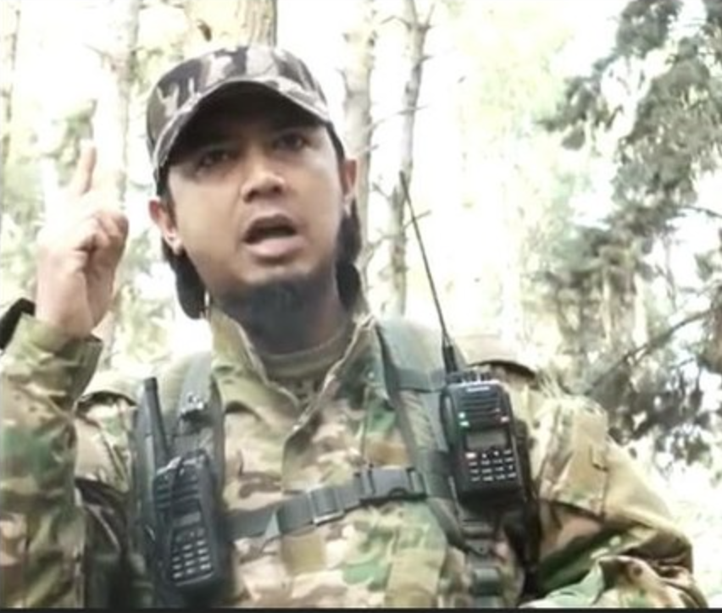
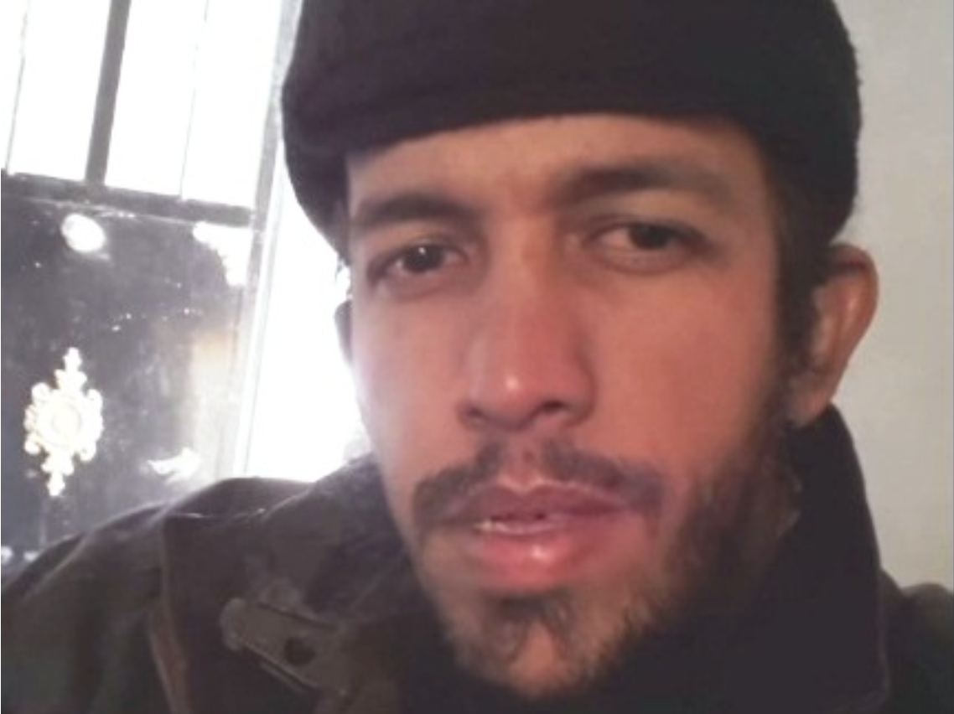
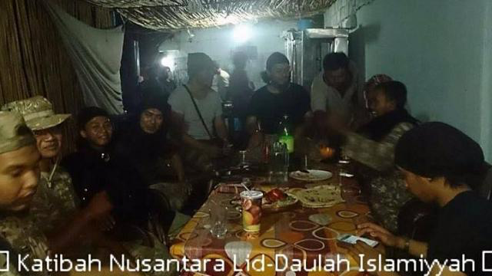
Bahrun Naim (June 2018)
Bahrumsyah (March 2017)
Abu Jandal (Nov 2016)
Muhammad Wanndy Mohamed Jedi (April 2017)

Slide 9
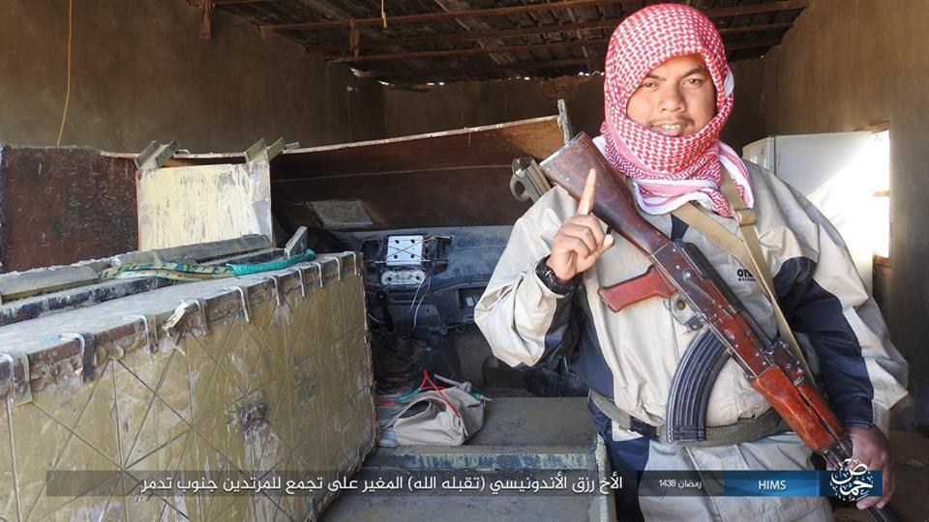
2017

Slide 10
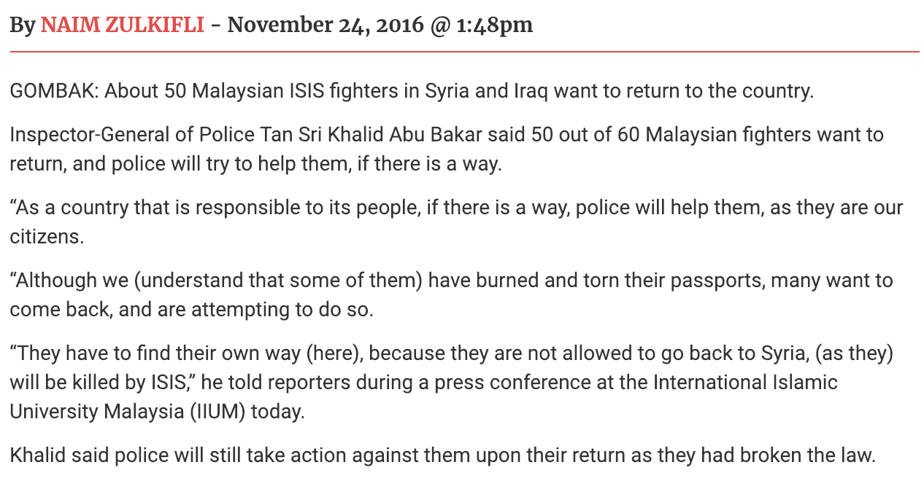
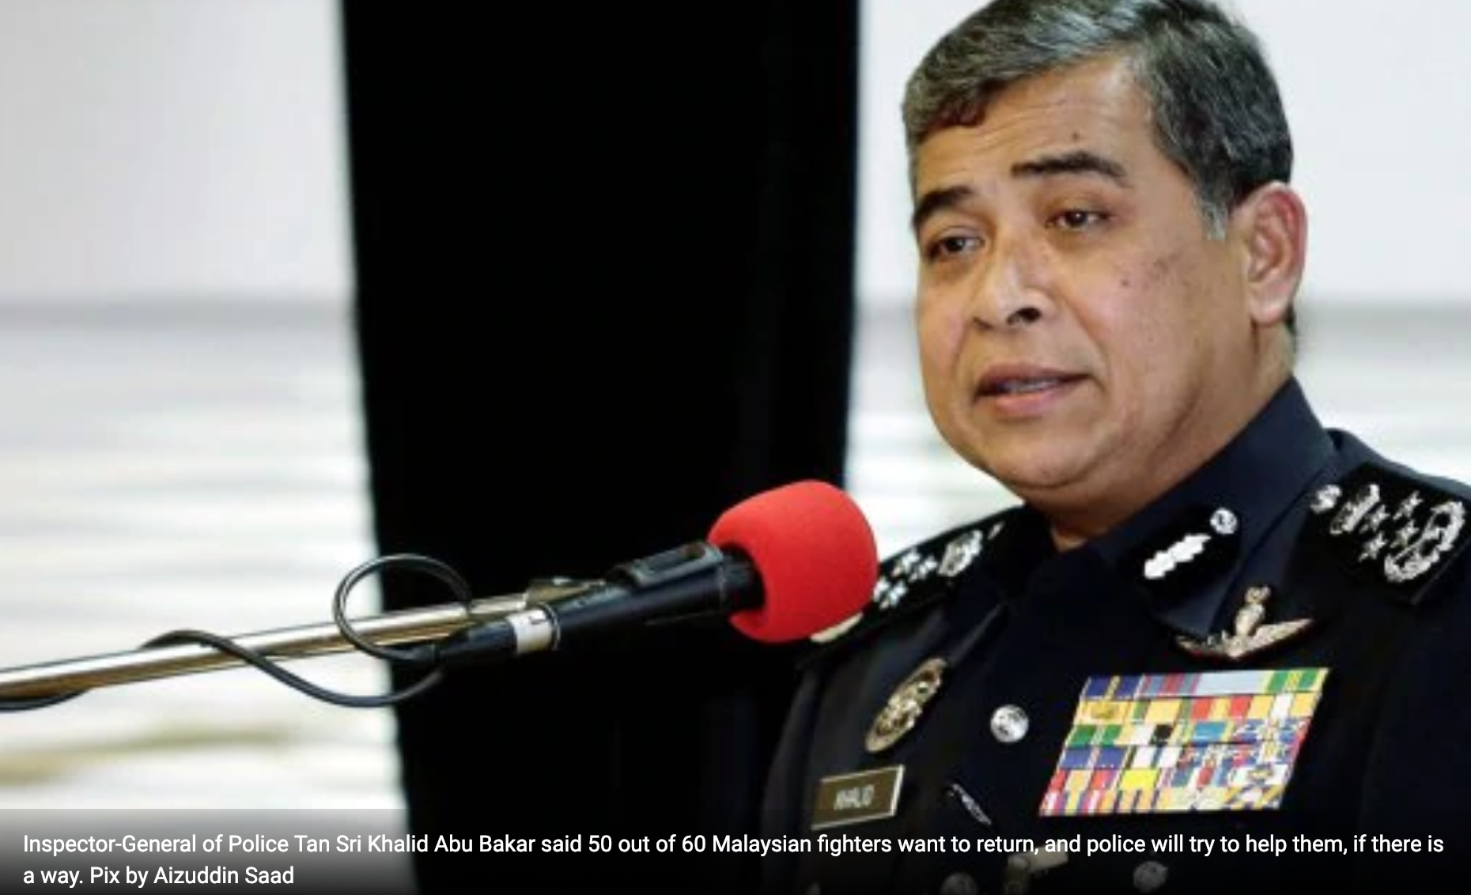
New Straits Times (Malaysia), 24 Nov 16
Al-Hol camp (Syria) – approximately 50 Indonesians

Slide 11
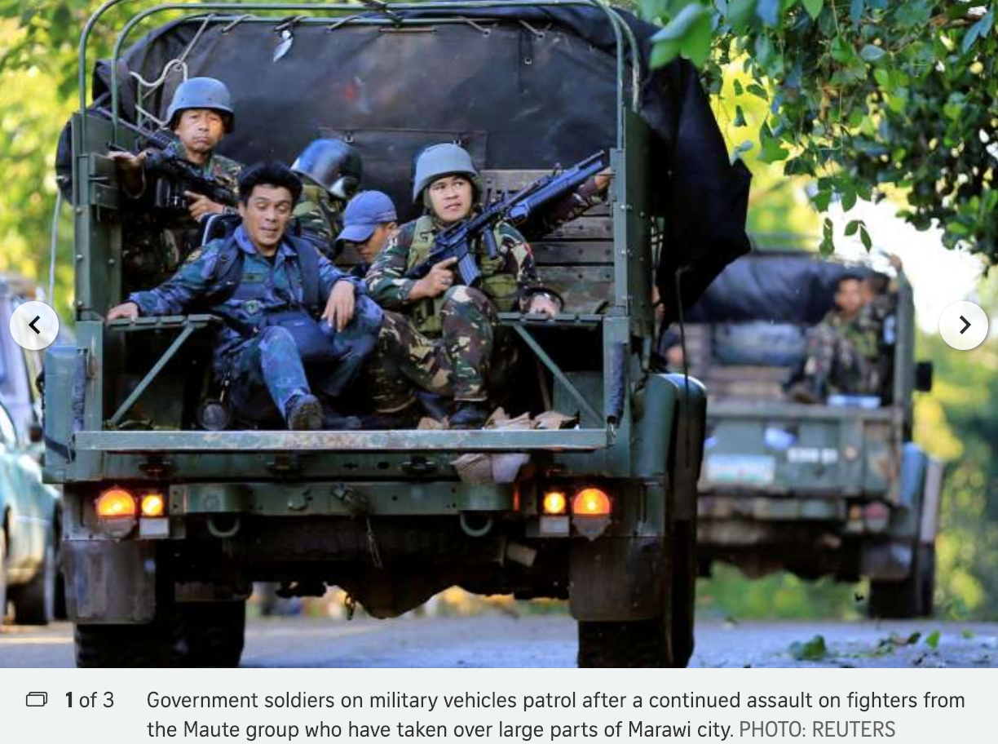
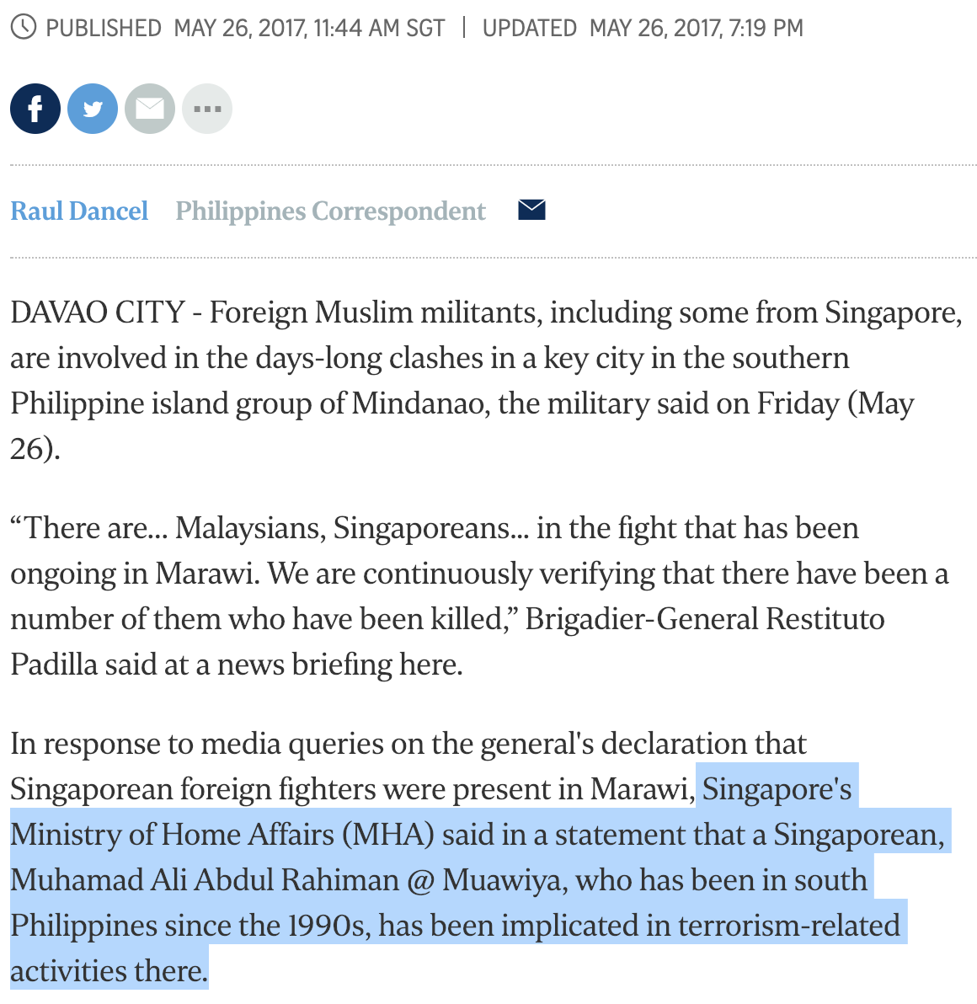
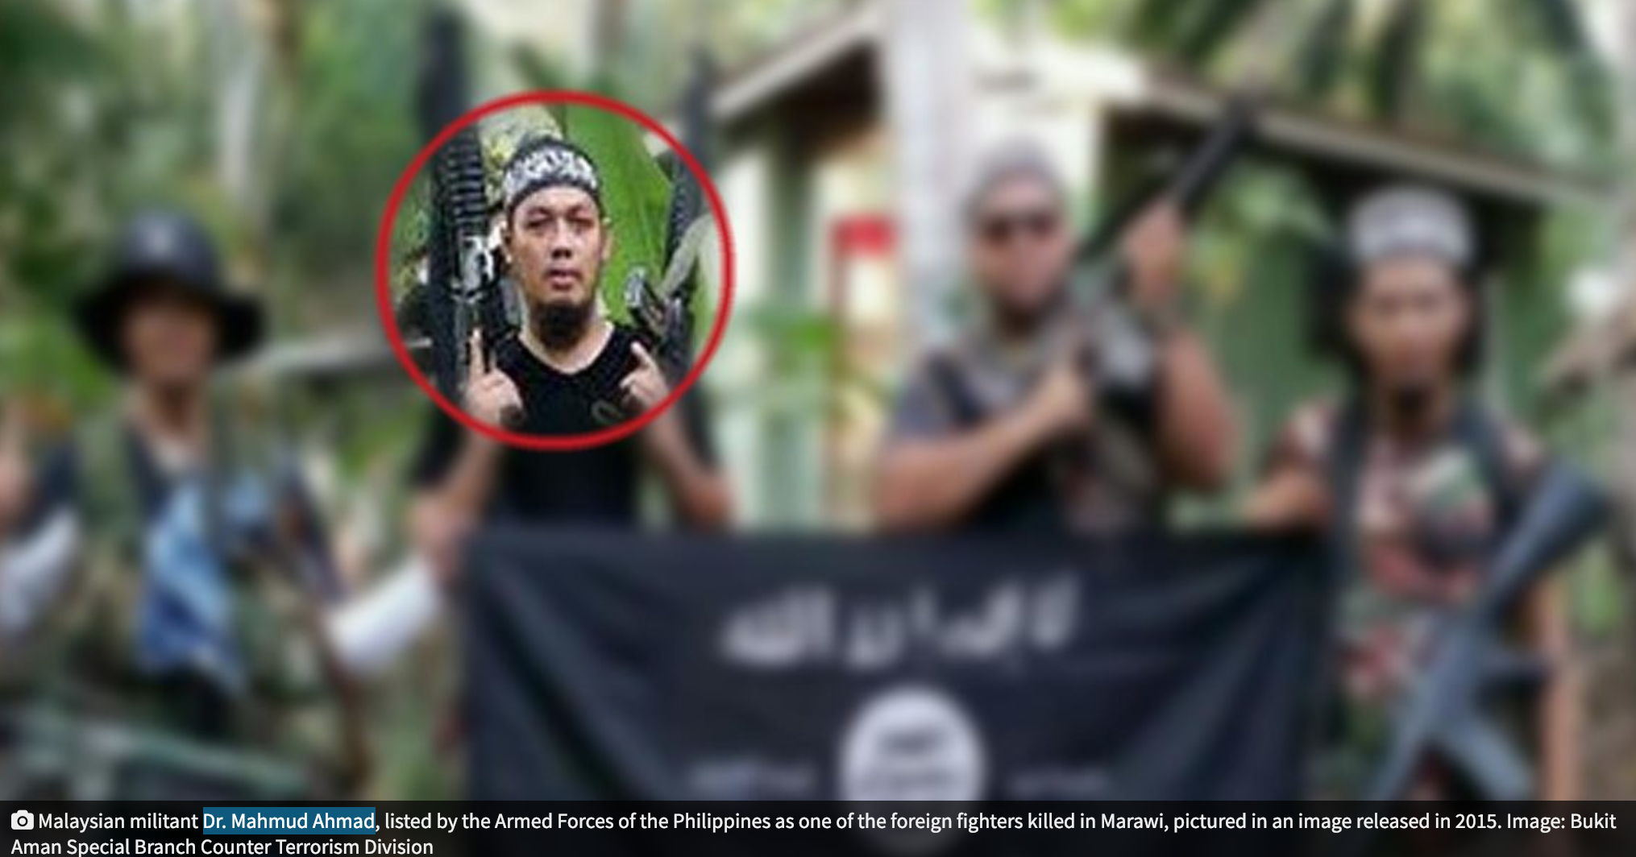
Muhamad Ali Abdul Rahiman @Mauwiyah
Dr Mahmud Ahmad

Slide 12
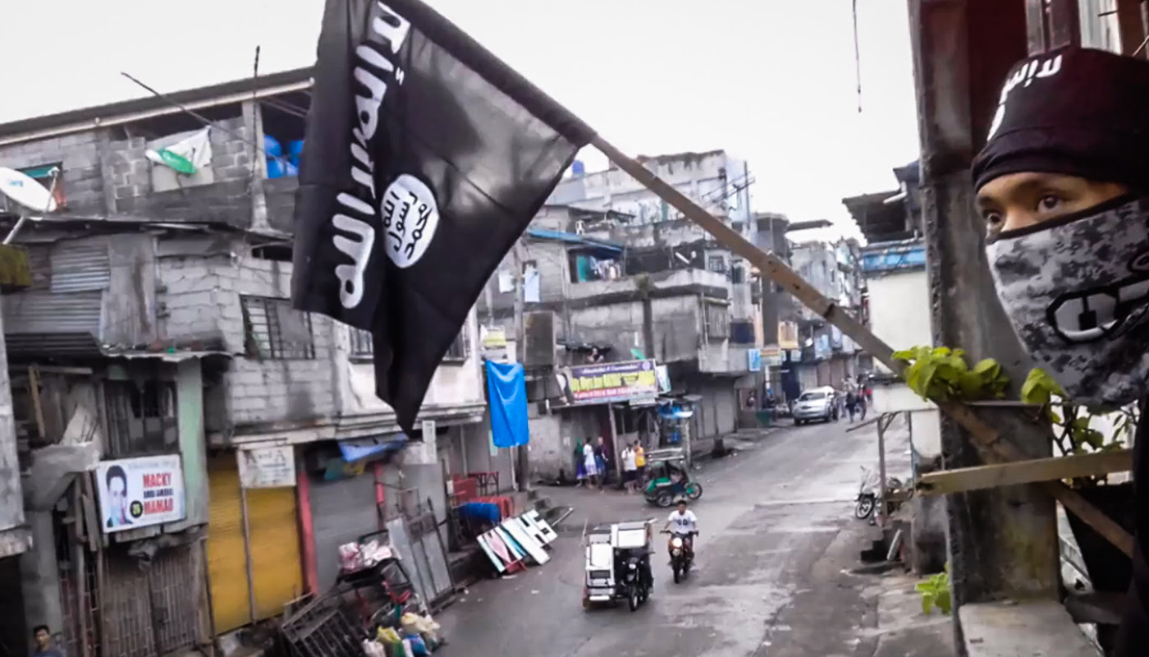
Marawi (May-Oct 2017)

Slide 13
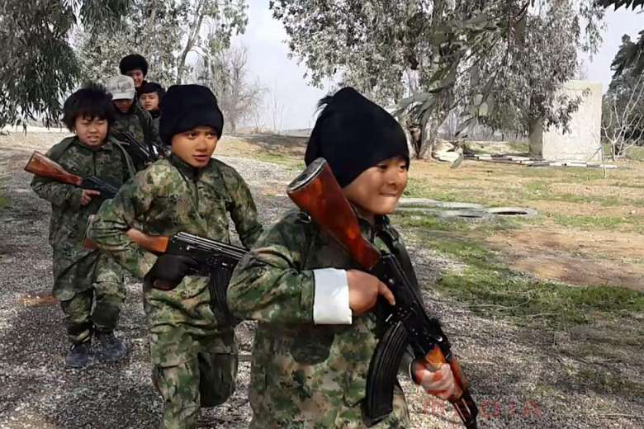
Children : The Next Generation

Slide 14
“EDUCATION IN THE CALIPHATE” VIDEO (March 2015)

Slide 15
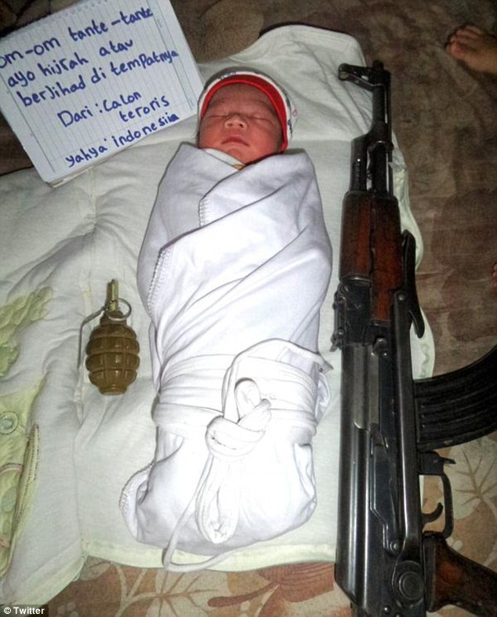

Slide 16
Media, Influencers, Cheerleaders, Disseminators

Slide 17
“We are in a battle, and...more than half of this battle is taking place in the battlefield of the media.”
- Ayman al-Zawahiri, Zawahiri’s Letter to Zarqawi, 2005
“There is a group of media operatives and companions of the pen that has a prominent and important role in steering the war, shattering the morale of the enemy and raising the spirits of the ummah.”
- Osama bin Ladin, 2002 Statement

Slide 18
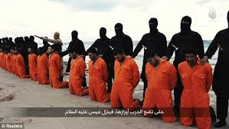
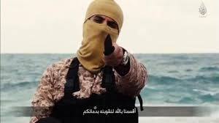

Slide 20
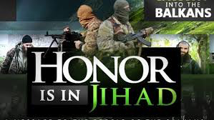

Slide 21
Call of the Caliphate
Al-Hayat Media Centre

Slide 22
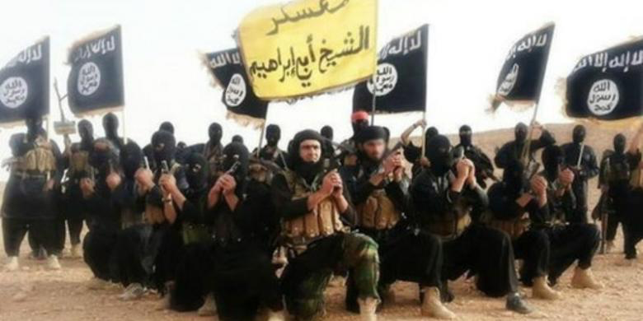
Foreign Fighters & ISIS Propaganda

Slide 23
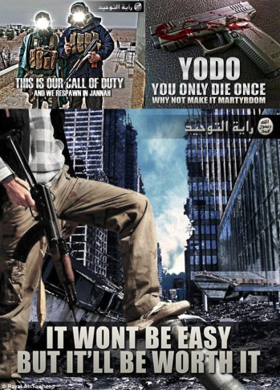
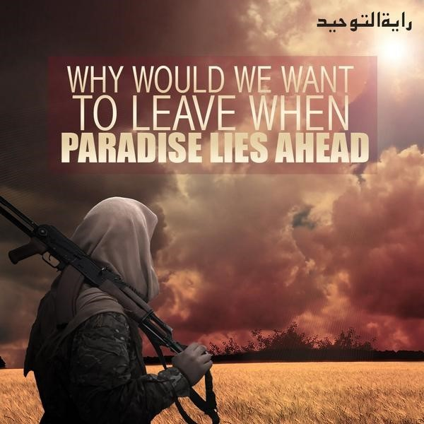

Slide 25
Malaysian Doctor aka ‘Bird of Jannah’

Slide 27
SINGAPORE

Slide 28
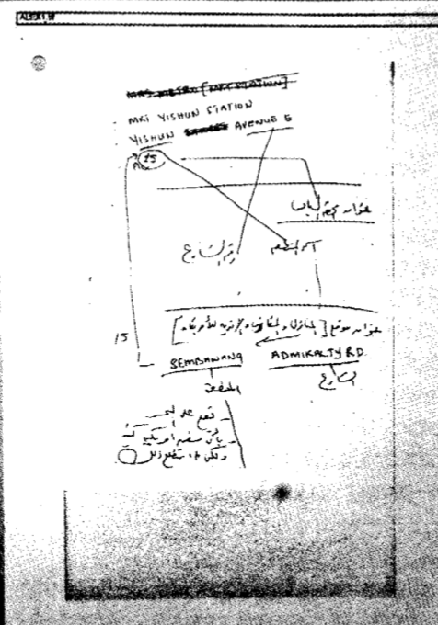
JI arrests/Yishun MRT (2001)

Slide 29
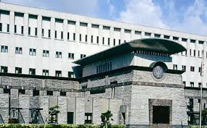
Singapore Embassies Attack plot (c.2001)

Slide 30
SITUATION HAS EVOLVED

Slide 31
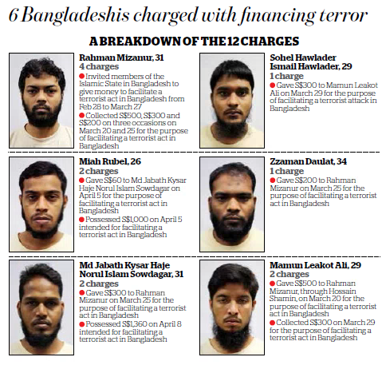
“Self-Radicalised” Foreign Workers (Jan + May 16)

Slide 32
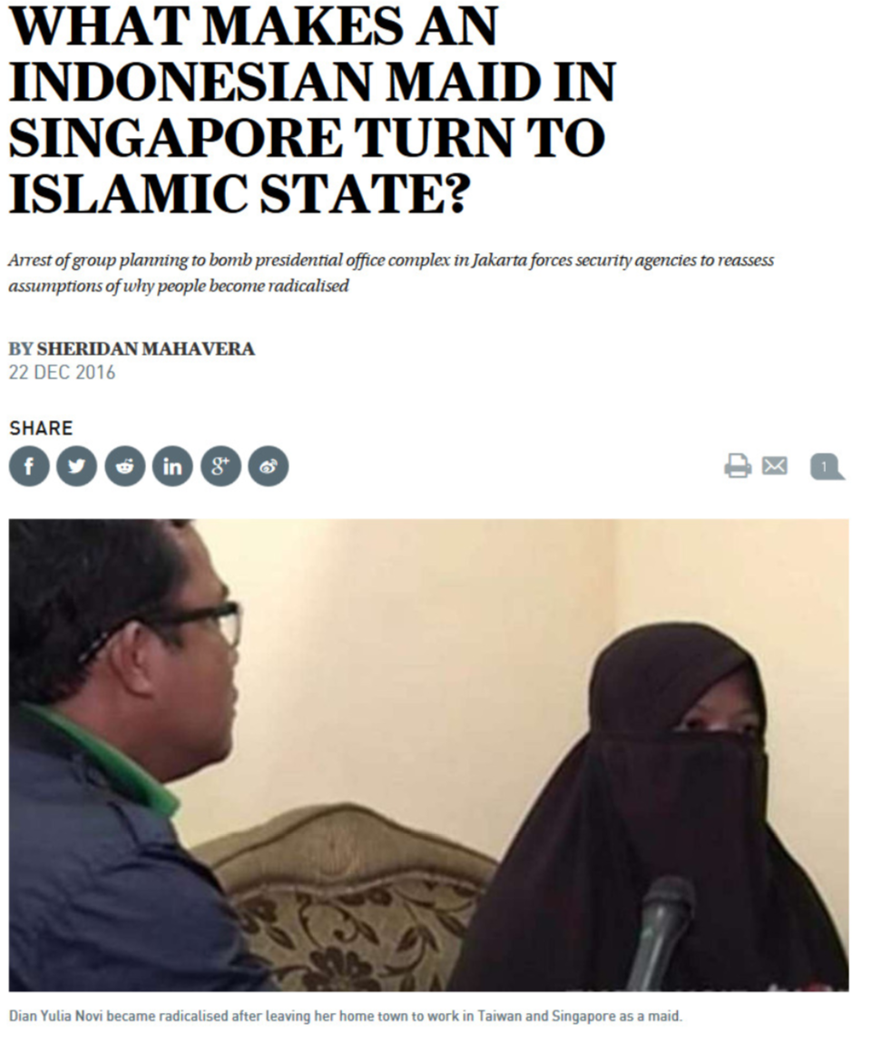
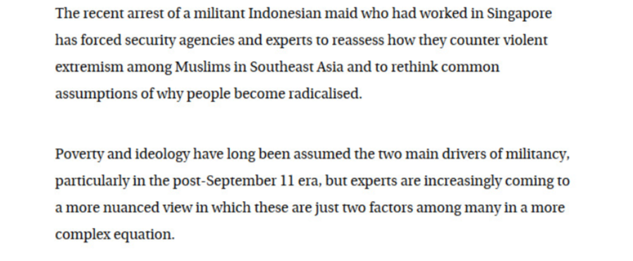
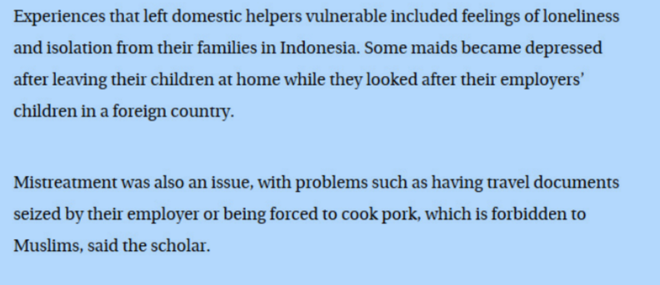
South China Morning Post 22 Dec 16

Slide 33
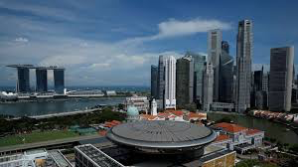
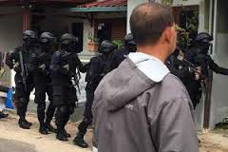
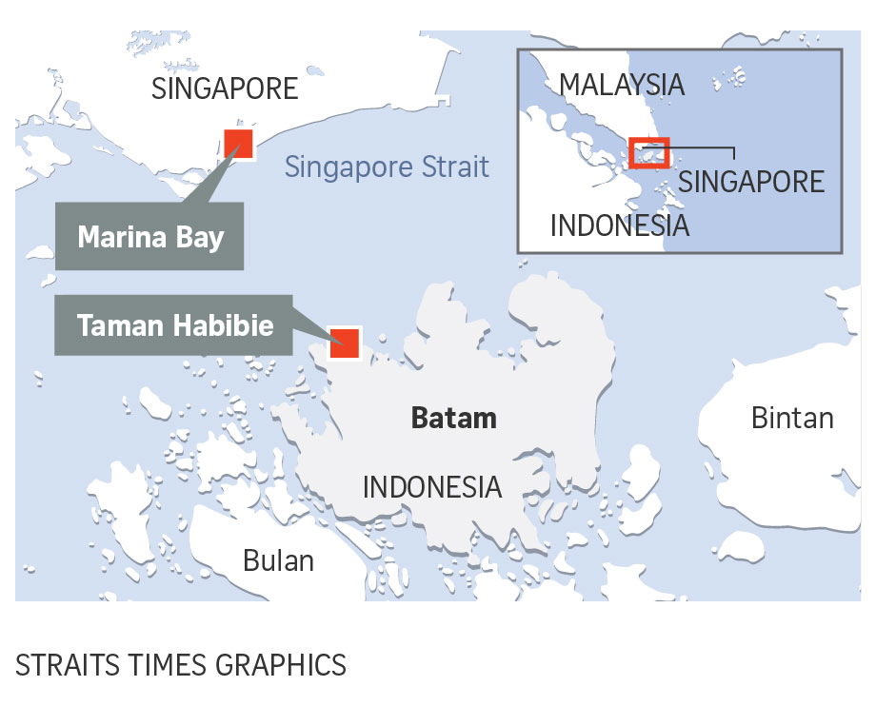
Marina Bay Rocket Attack Plot (2016)

Slide 34
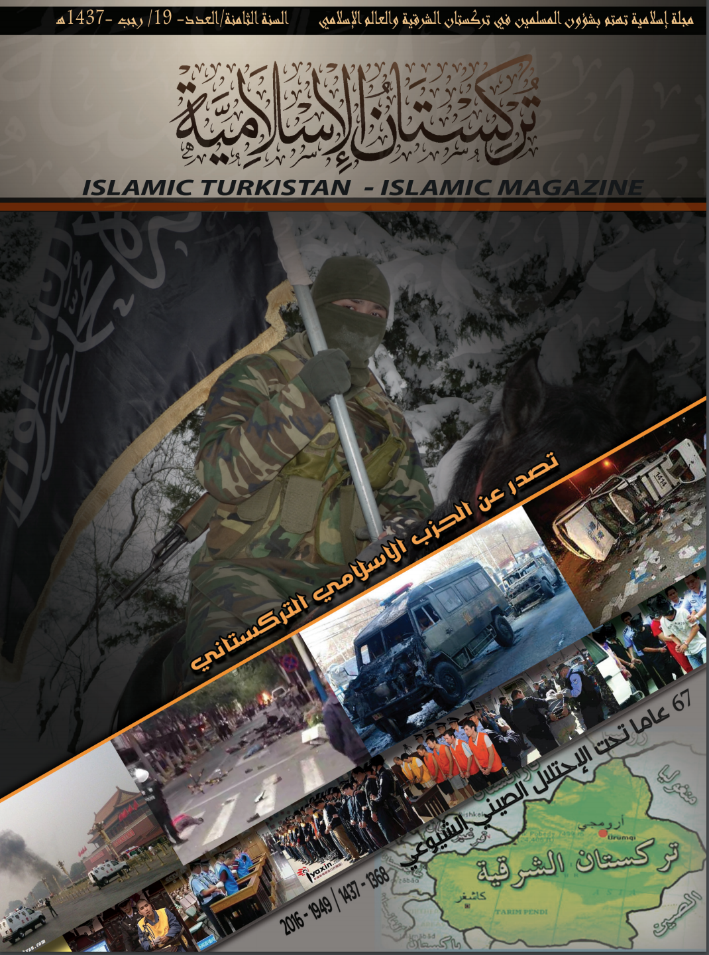
There is no doubt that many of the lands of the Muslims are occupied by the infidels and some of them for centuries, from Andalusia to the west and the sides of southern Europe, Central Asia, the Balkans, the Caucasus and the like, to East Turkistan in western China to many countries of South East Asia, Singapore, and others, and even India, and large parts of them, and others, were all at one time the country of Islam and Dar Islam and then taken by the enemy infidel. Muslims rid themselves of the infidels, and then restore the rest of the land of Islam from the land of Arabs. These must be fought and fought, and whoever is capable of doing so must fight against the law of the unbelievers. Therefore, there is progress for the infidels now (America and its allies) to oppose their submission. Who is doing this jihad? How can we say that jihad is enough?
Hizb al-Islami al-Turkistani, "Turkistan al-Islamiyyah", issue 19, page 57, April 2016
https://emaad.net/

Slide 35
Singapore’s Self-Radicalized

Slide 36
Situation in Singapore has evolved
93 arrested/detained since Dec 2001; of which approx 72 JI or JI linked.
Most of terror detainees arrested since 2001 (JI) released, after they were deemed to have been sufficiently rehabilitated (≈ 85 per cent success rate)
11 (?) still in detention
YOUTH RADICALISATION:
Since 2015, the authorities have detained five teens aged between 17 and 19.
"We find a common thread when we pick them up. A heavy reliance on the Internet, social media, for information, including religious teachings”
Self-radicalised individuals today face "more complex psychological and social issues" and Singapore is still trying to develop the right tools to rehabilitate them
Home Affairs Minister K. Shanmugam (The Straits Times, 14 Mar 18).
To date, just 25 per cent of such self-radicalized individuals detained since 2007 have been released.

Slide 37
It used to take around 22 months for people to become radicalised, the timeline has shortened to 9 months in the ISIS era.
Eleven individuals were detained under the preventive ISA between 2007-2014.
But there has been a significant rise subsequently, with the period from 2015-2019 alone seeing a further 22 radicalised individuals detained.
Ministry of Home Affairs Terrorism Threat Assessment Report, June 2017
https://www.mha.gov.sg/newsroom/press-releases/newsroom-detail-page?news=singapore-terrorism-threat-assessment-report-2017

Slide 38
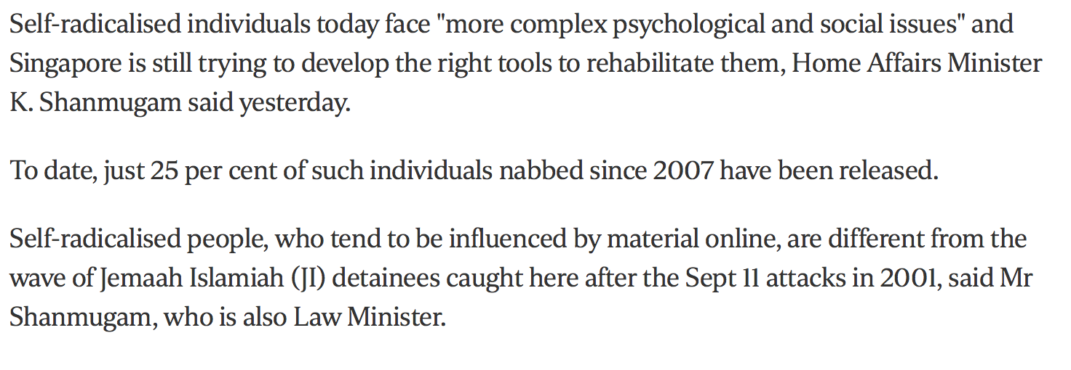
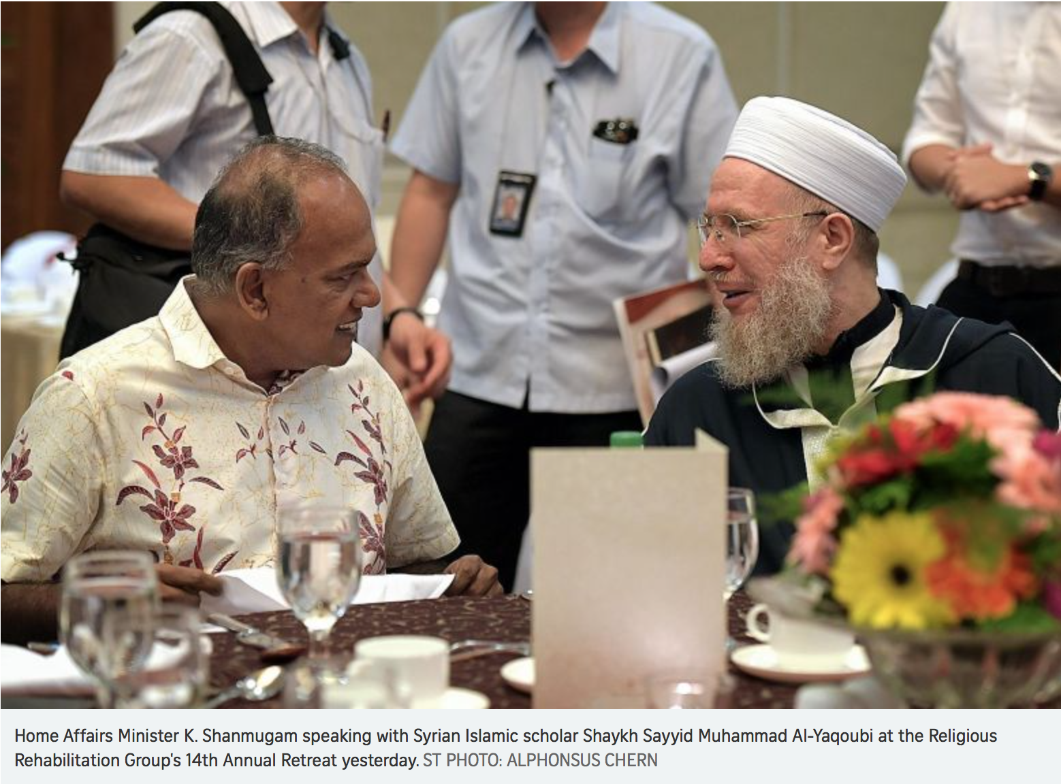
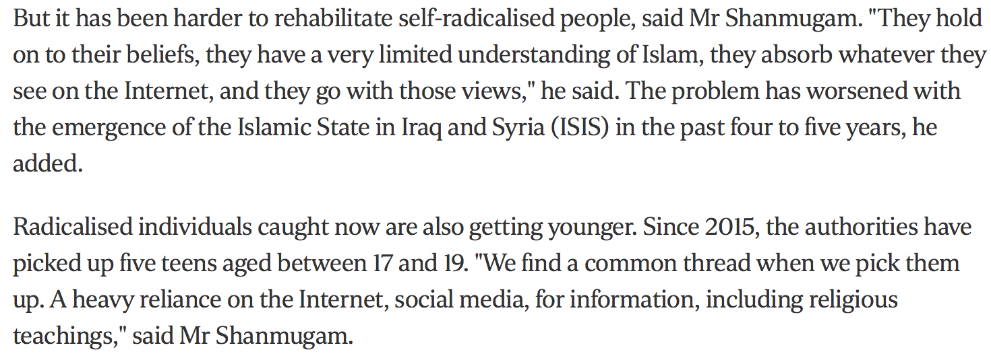
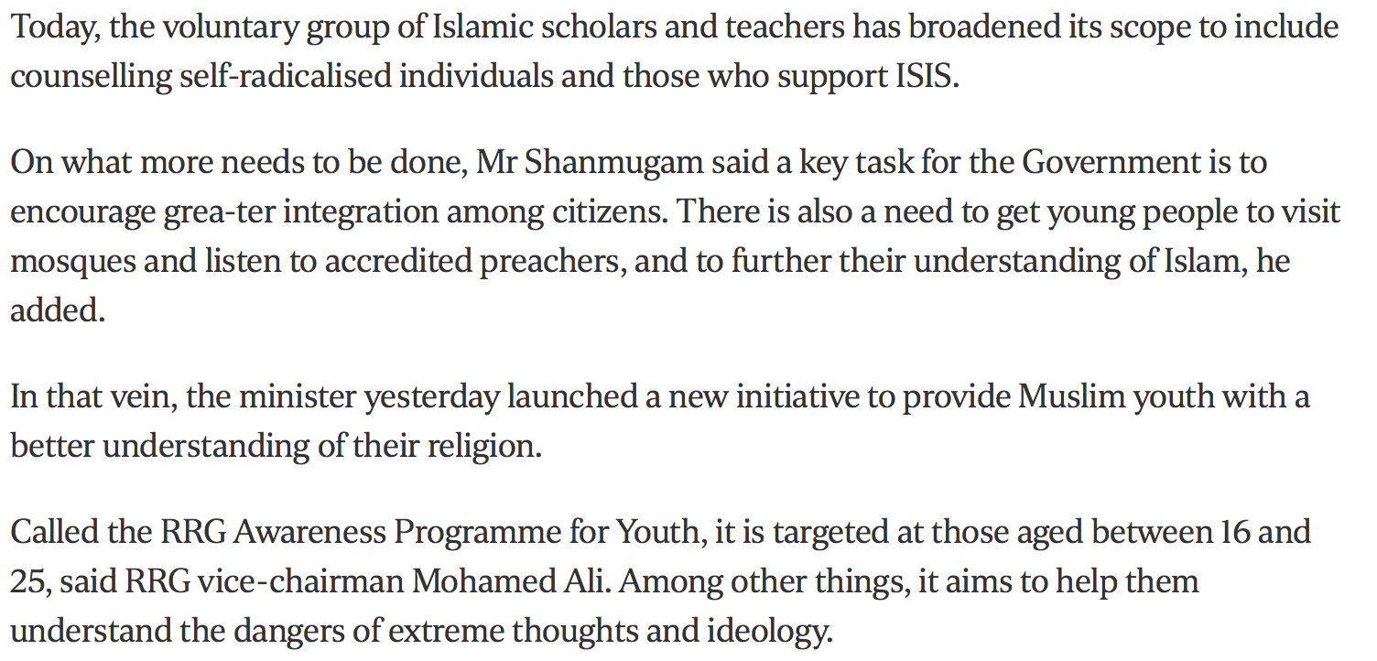

Slide 39
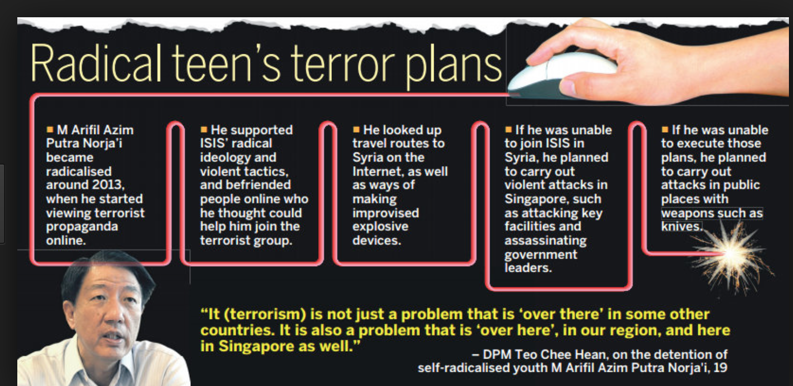
Self-radicalisation /DIY attacks

Slide 40
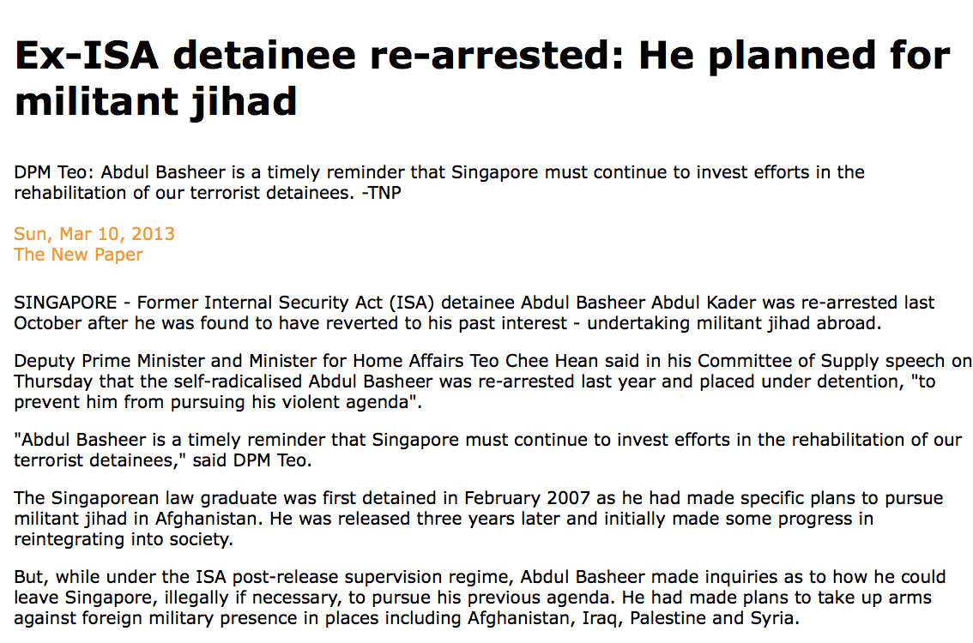
Self-Radicalisation

Slide 41
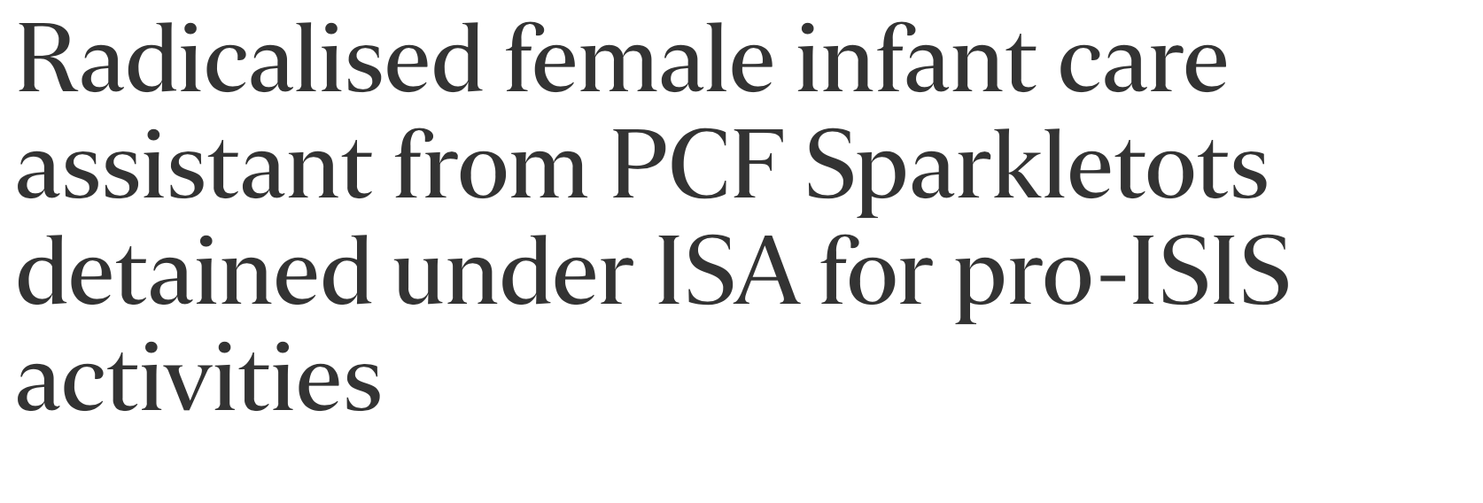
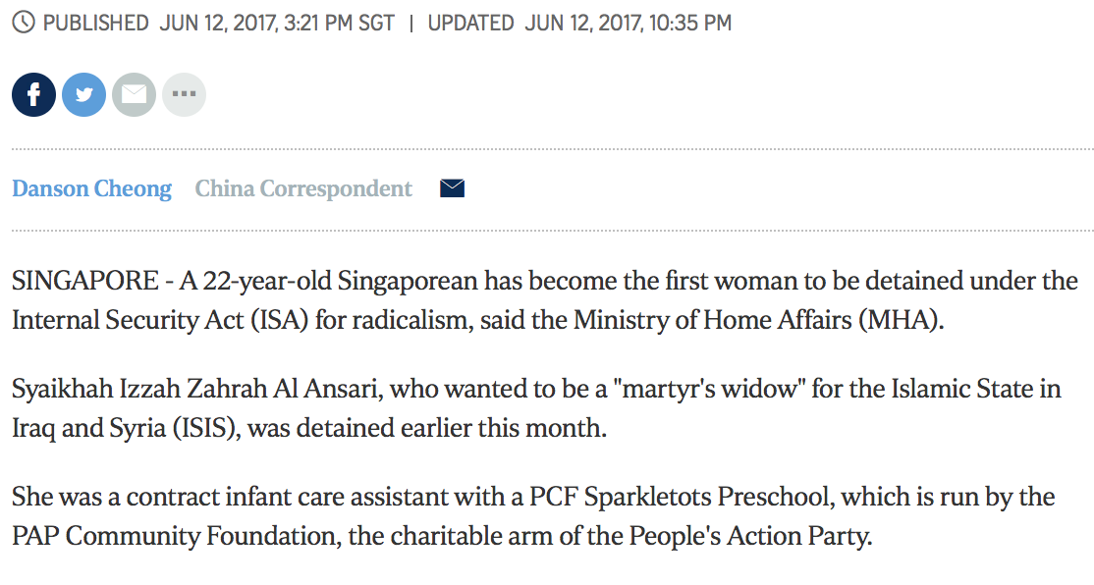
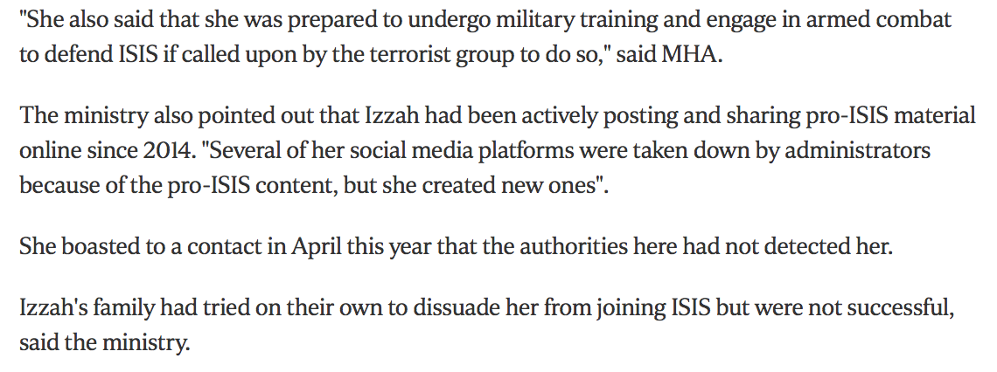
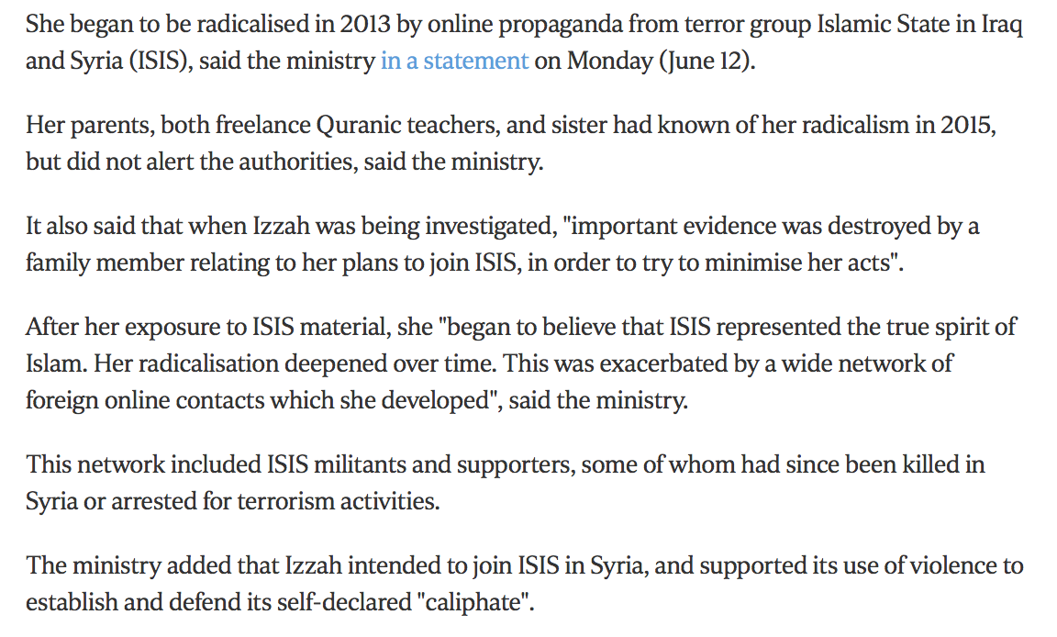

Slide 42
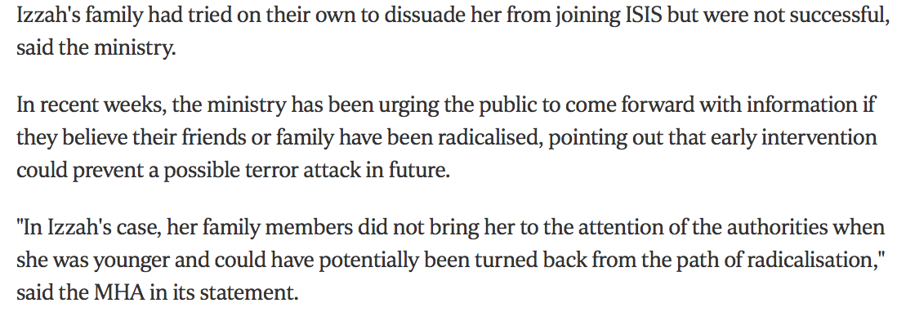
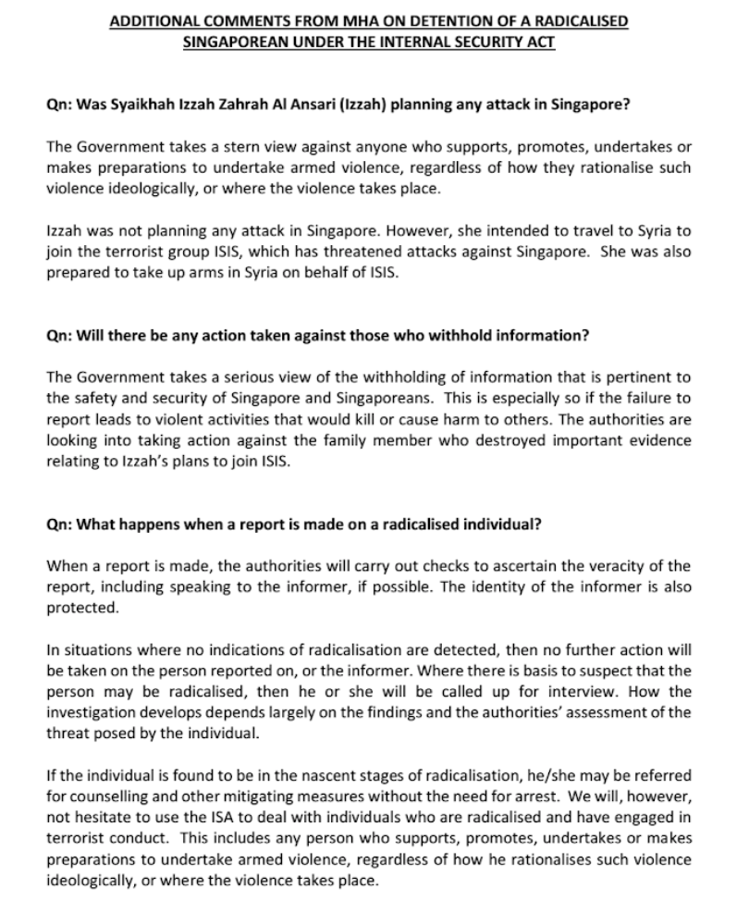
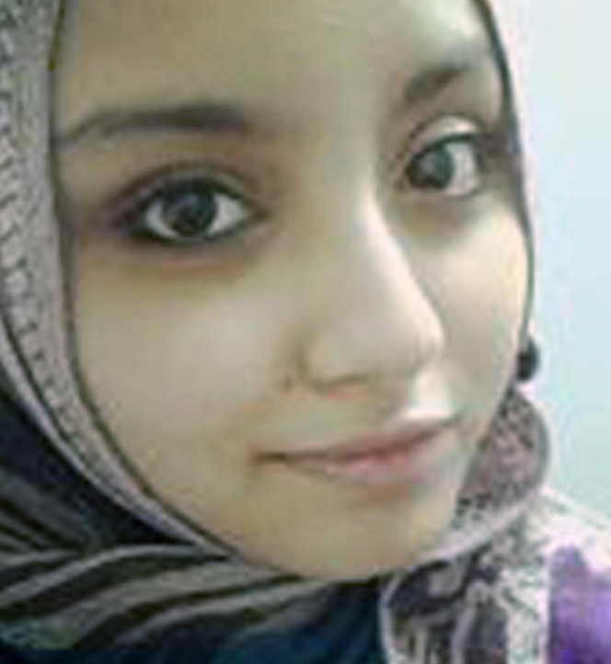
MHA’s concerns

Slide 43
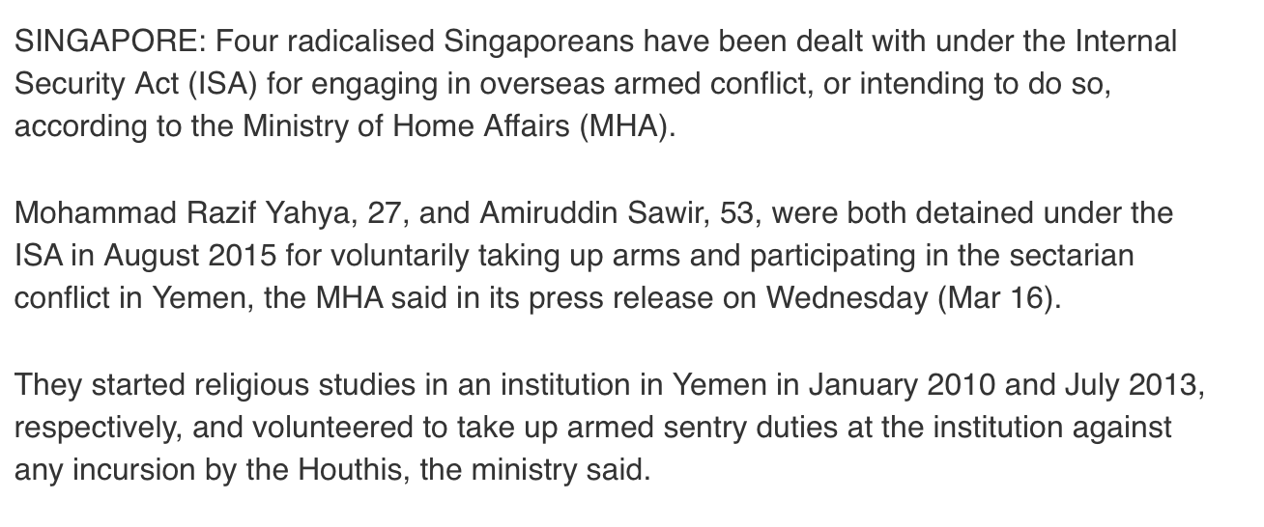
Other conflicts
Source: ChannelnewsAsia, 16 Mar 16

Slide 44
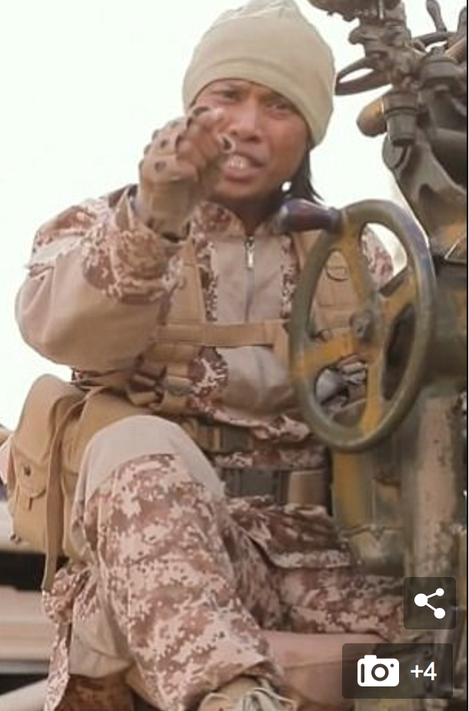
Abu Uqayl

Slide 45
WHY?

Slide 46
Singapore : recent cases
One youth believed that violence was legitimate and necessary to fulfil God’s obligation for all Muslims to be united in an Islamic caliphate. Violence against Muslims and non‑Muslims who did not agree was justified.
One youth planned to engage in violence in a conflict zone after coming across content concerning Muslims’ suffering in that area: not helping meant that he had failed as a Muslim. He started looking at a range of jihadi websites and came to the conclusion that he had to take up arms to alleviate the plight of Muslims.

Slide 47
Recent cases (II)
Factors might include family conflicts, difficulties in school or other life stressors. Some youths seek meaning and certitude.
Some display poor coping strategies in connection to issues with school, relationships or financial problems. Rather than seeking guidance or social support, some choose to get involved with IS. Making plans to join IS is an avoidance strategy instead of thinking and solving the problem at hand: ‘a pattern that was found suggested the utilisation of poor coping strategies in dealing with problems.
Common avoidance coping strategies observed in local radicalised youths are the tendency to engage in behavioural attempts to get involved in substitute activities as a way of either creating new sources of satisfaction in their lives or as a way to distract from the stressor.

Slide 48
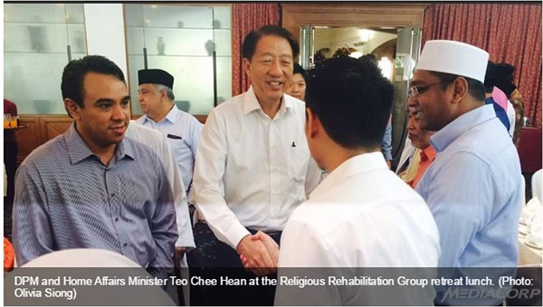
The Singapore Way : RRG

Slide 49
RRG and Inter-Agency AfterCare Group (IACG)
Emphasis on helping families of detainee
Important psychological effect on detainee
Preventing family members from falling prey to radical ideology

Slide 50
Religious Rehabilitation Group (RRG)
Founded in April 2003 following the arrest and detention of Jemaah Islamiyah members
RRG has performed more than 1,500 counselling sessions, which also extend to the family members of detainees
In collaboration with other agencies, RRG conducts workshops and seminars at schools and mosques.
Next stage : the online narrative/counternarrative challenge

Slide 51
Other Examples of RRG work
Religious counsellors save two secondary schoolboys from further radicalisation One developed an interest in global affairs involving Muslims and became convinced of the need to migrate to an Islamic caliphate. Another penned pro-Islamic State (IS) slogans in his school books that were discovered by his father
In both cases, which involved secondary schoolboys, relatives and friends became concerned enough to alert the Religious Rehabilitation Group (RRG). The boys met with RRG counsellors, who explained religious concepts and the IS’ violent ideology to them.
The secondary schoolboys felt they benefited from the sessions with RRG counsellors and realised the danger of supporting ISIS
Another case was of a wife who noticed her husband becoming more vocal about a much stricter form of Islam, holding the exclusivist view that loyalty could only be given to God and Muslims. She confided in her relative, who approached RRG for advice. The wife spoke a few times over the phone with a counsellor on how she could advise her husband not to hold such extreme religious views.

Slide 52
RRG’s Challenges : Self radicalization
RRG has to adapt (from dealing with groups to self-radicalized individuals)
Dealing with cyberspace

Slide 53
New Radicalisations

Slide 54
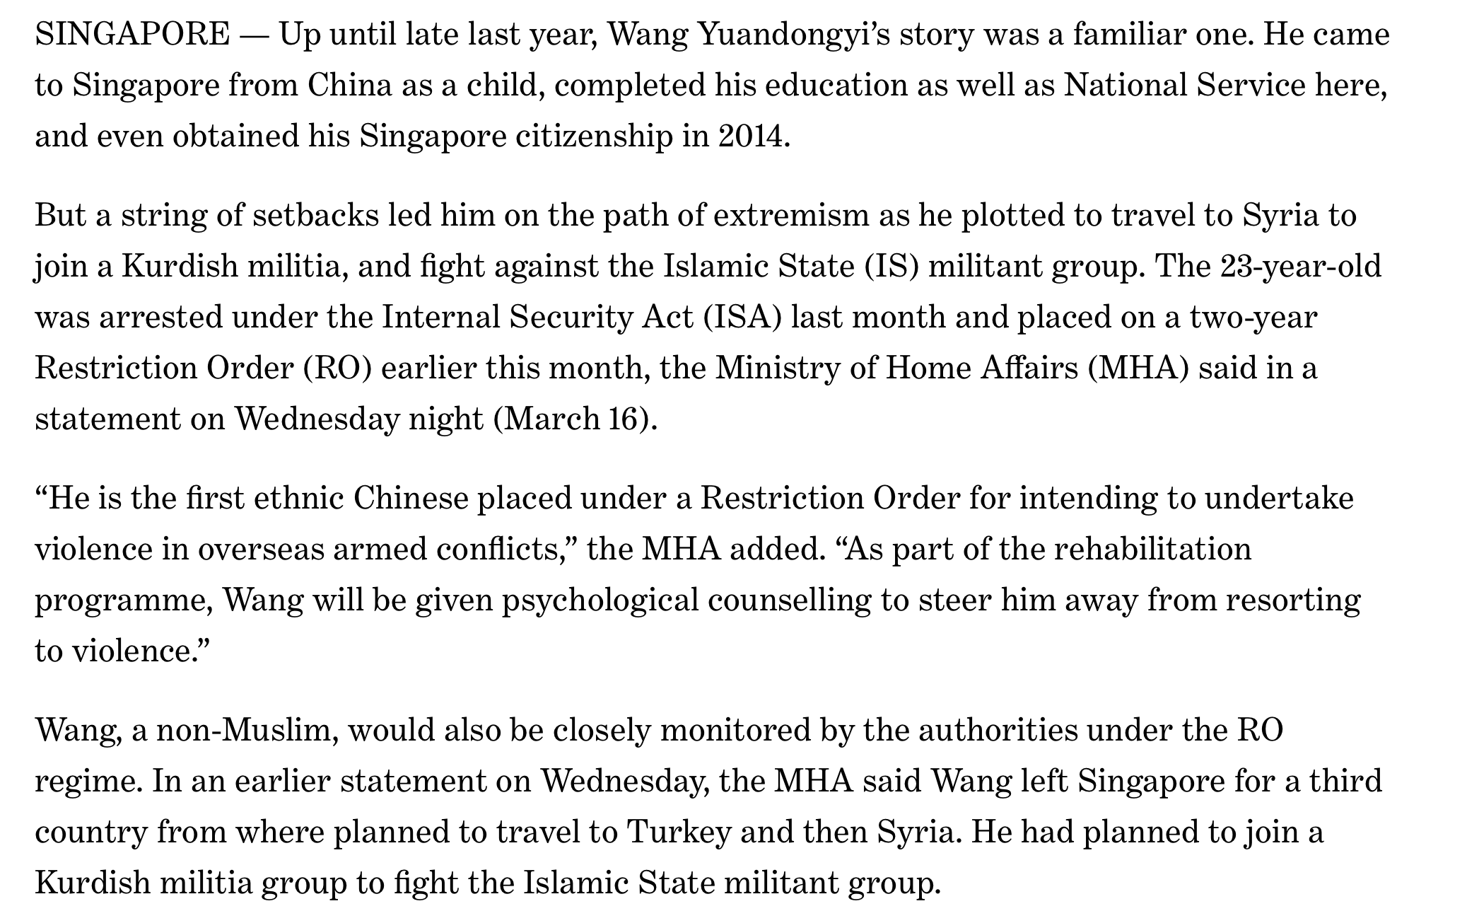

Slide 55
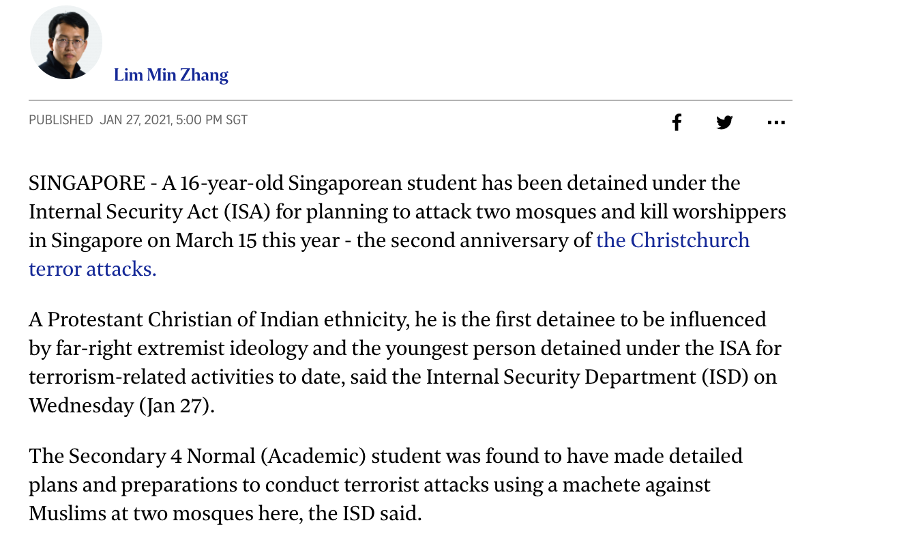
Right Wing Youth detained December 2020
- Indian, Protestant
Idolised Brenton Tarrant
Planned attacks on same date
Fascinated by violence
Fears of “Great Replacement”
https://www.straitstimes.com/singapore/16-year-old-detained-under-isa-for-planning-terrorist-attacks-at-two-mosques-in-singapore

Slide 56
Other Perspectives

Slide 57
What are some connecting strands?
Persecution complex, preserving “authentic” religion/nationality/identity. Fears of extinction of an identity
People who feel that their nation or culture has somehow gone off the rails and that they need to take steps to “protect” it
Lack of political leadership?
What is common between the UK/Europe context, and parts of Asia is that many people in the majoritarian ethnic/religious identify their nation only as that. No place for minorities.
Through their hyperboles and myths, the supremacists fan the insecurity among the already marginalized minority. This in turn pushes the “othered” minorities to huddle around their exclusive symbols.

Slide 58
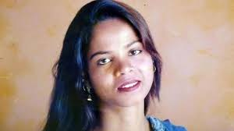
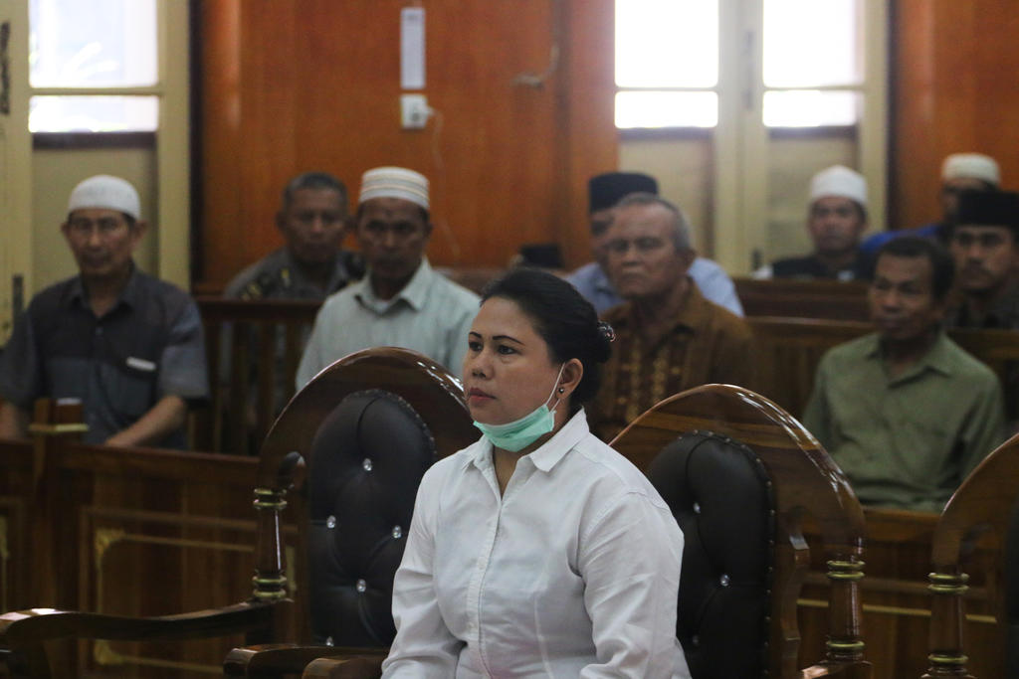
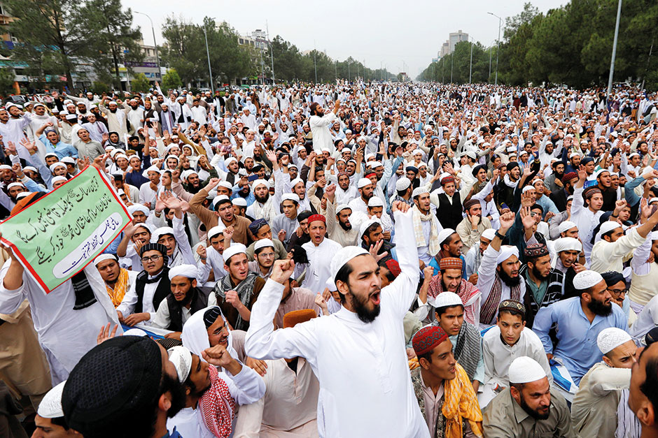
What are the connecting strands? (II)
“Manufacture of Offence”
Asia Bibi
Meiliana, a 44-year-old ethnic Chinese Buddhist, in a Medan court on August 2018

Slide 59
The Future/Upstream Initiatives

Slide 60
“Aarhus Model” (Denmark)
COMPARISON
Close cooperation between Schools, Social Services, Police (SSP)
Importance of Mentoring
Emphasis on Disengagement, NOT Deradicalization

Slide 61
Reflections of an Aarhus Mentor
It is also pivotal that you make room for dialogue. This aspect is the backbone of the program. Dialogue makes the mentee reflect, rethink and reconsider in terms of the mentee's life and surroundings. In the atmosphere of dialogue I could challenge the mentee's points of view and worldviews in order to give perspectives and again promote reflection and new choices in life.
By extension, I see the mentor program as a 'help to self help', or to put it differently, it is also about empowerment. I do not take charge of or take over the mentee's life. I try to be a discussion partner, an advisor and give guidance, but it is the mentee who has to make the crucial choices. Mentee X said to me at some point that I have saved his life (in terms of refraining from going to Syria and fight). But I answered that he himself had saved his own life. I just tried to nuance the conversations and establish new and alternative option for actions.

Slide 62
SINGAPORE : UPSTREAM INITIATIVES
Interfaith Youth Circle, Roses of Peace ; Organic Movements

Slide 64
The Straits Times

Slide 65
Good work done by other organisations : Inter-Religious Organisation and Inter-Racial Confidence Circle

Slide 69
Grassroots Reactions?

Slide 70
THANK YOU

